Slide 1
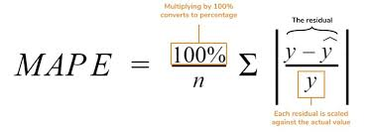
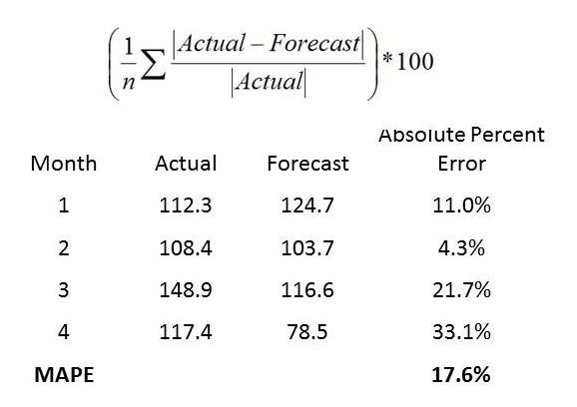
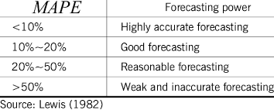
MAPE – Mean Absolute Percent Error
Error Estimates in Forecasting

Slide 2
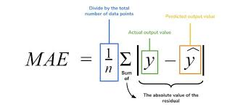
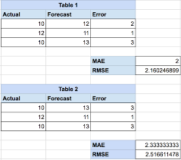
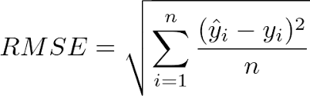
RMSE/MAE – Root Mean Squared Error/Mean Absolute Error
Error Estimates in Forecasting

Slide 3
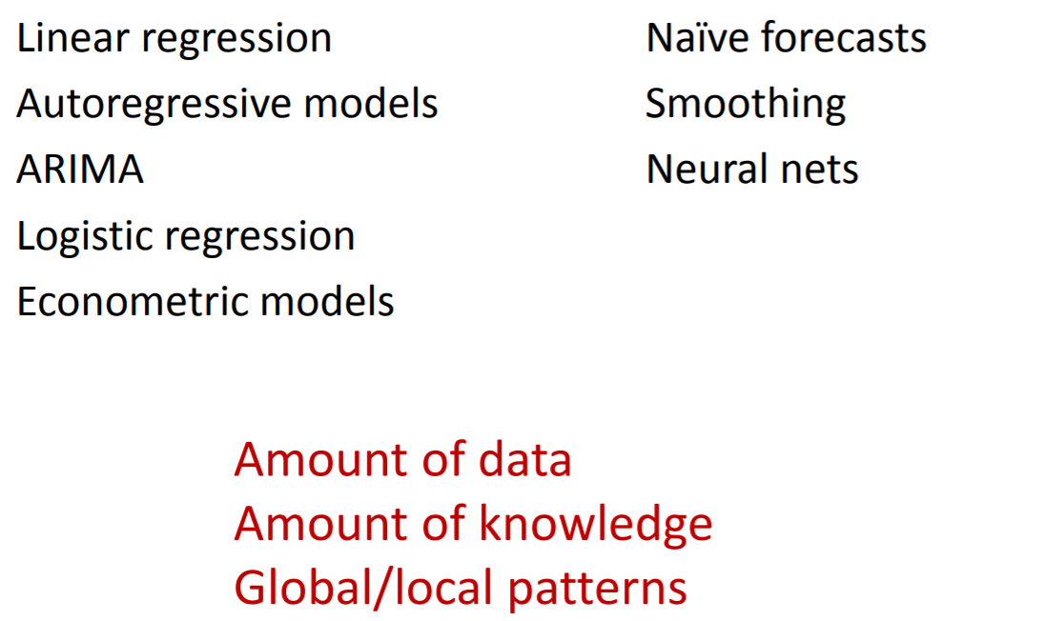
Forecasting Models
Models for Forecasting

Slide 4
Smoothing Methods – Moving Averages
The Idea:
Forecast future points by using an average of several past points
Advantages: Simple, popular
Smoothing Methods
a long time series
a series with no trend
a series with no seasonality

Slide 5
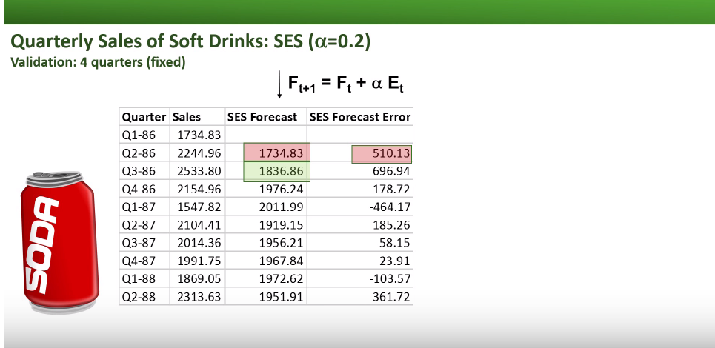
Simple exponential smoothing – No trend and no seasonality
Assumption: Series has only level (L_{t}) and noise.
Noise is unpredictable ; Level will “stay put”
Forecasts = estimated level at most recent time point: F_{t+k} = L_{t}
Adaptive algorithm: adjusts most recent forecast (or level) based on the actual data: F_{t} = αY_{t} + (1-α) F_{t-1 ,} α = the smoothing constant (0<α≤ 1)
The formula: L_{t} = αY_{t} + (1-α) L_{t-1 ,}
Simple exponential smoothing only alpha
F_{t+1} = L_{t} = L_{t-1} + α (Y_{t} - L_{t-1} )
= F_{t} + α (Y_{t} - F_{t} )
= F_{t} + α E_{t}
update previous forecast
By an amount that depends on the error in the previous forecast
α controls the degree of “learning”

Slide 6
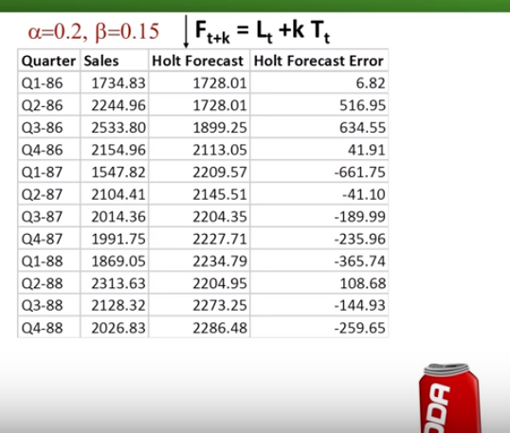
Holt’s exponential smoothing/Double – Have trend but no seasonality
L_{t} = αY_{t} + (1-α)( L_{t-1} + T_{t-1})
Holt’s exponential smoothing
Alpha & beta
Adjust the previous level by adding trend
T_{t} = β (L_{t} -L_{t-1}) + (1- β) T_{t-1}
Update previous trend using the difference between the most recent level values.

Slide 7
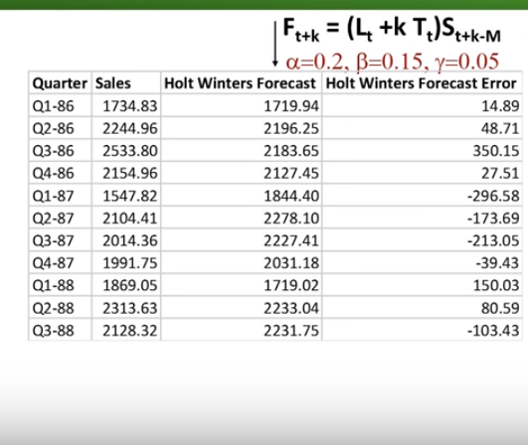
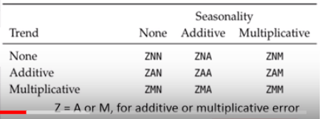
Winter’s Exponential smoothing/Holt’s Winter method – Have trend and seasonality
Forecasts take into account level, trend, and seasonality:
F_{t+k} = (L_{t} + k T_{t} ) S_{t+k-M}
Winter exponential smoothing
Alpha, beta & gamma
number of seasons
S_{t} = seasonal index of period t

